Slide 1
Ethernet Basics
RJ-45 Pin outs and Category 5 Wiring
The EIA/TIA defines the cabling specifications for Ethernet LANs
EIA/TIA define two standards: T568A & T568B
PINS T568A PINS T568B
1 G/W 1 O/W
2 Green 2 Orange
3 O/W 3 G/W
4 Blue 4 Blue
5 B/W 5 B/W
6 Orange 6 Green
7 Br/W 7 Br/W
8 Brown 8 Brown

Slide 2
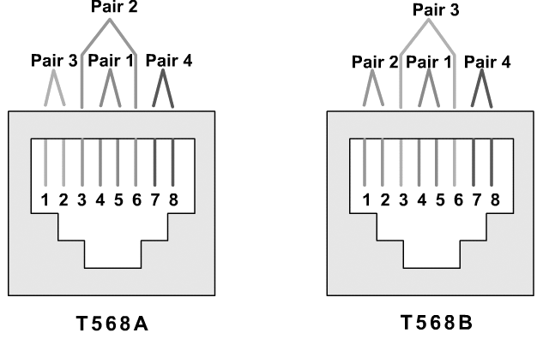
Ethernet Basics

Slide 3
Ethernet Basics
We can make Ethernet cable as straight through and crossover according to our requirement
Ethernet Cabling Types
Type of Cable Pinouts Key Pins Connected
Straight-through T568A (both ends) or T568B (both ends)
Cross-over T568A on one end, T568B on the other

Slide 4
Ethernet Basics
Many Ethernet standards use two twisted pairs, with one pair being used for transmission in each direction
A PC network interface card (NIC) transmits on pair 1,2 and receives on pair 3,6
Switch ports do the opposite. So, a straight-through cable works well, connecting pair 1,2 on the PC (PC transmit pair) to the switch port’s pair 1,2, on which the switch receives

Slide 5
Ethernet Basics
When the two devices on the ends of the cable both transmit using the same pins, a cross-over cable is required
If two connected switches send using the pair at pins 3,6 and receive on pins 1,2, then the cable needs to connect the pair at 3,6 on one end to pins 1,2 at the other end, and vice versa

Slide 6
Ethernet Technology
Standard Datarate Known as Cabe Max.Length
10 base 2 10 mbps Thinnet coaxia RG58 185 m
10 base 5 10 mbps Thicknet coaxial RG11 500 m
10 base T 10 mbps Ethernet TP (cat 3) 100 m
100 base T 100 mbps F.Ethernet TP (cat 5) 100 m
1000 base Tx 1Gbps G.Ethernet TP (cat 6) 100 m
1000 base Sx 1Gbps G.Ethernet Fiber (m.m) 550 m
1000 base Lx 1 Gbps G.Etherne Fiber (S.M) 2 km
Now new standard 10G base also introduced with twisted pair & Fiber cable that support 10 Gbps data rate

